Slide 1



Web and Internet
Class VI
lab 10

Slide 2

Email
Electronic mail is a method of exchanging messages between people using electronic devices

Slide 3
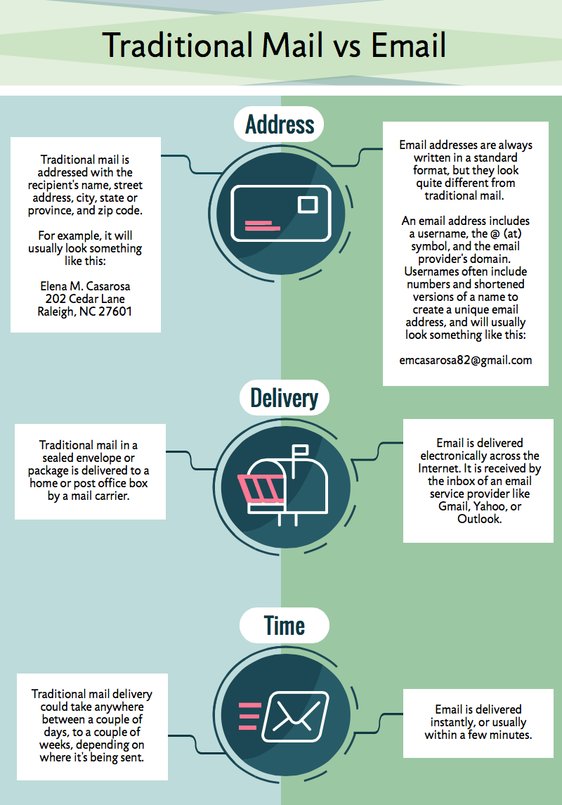
Traditional Mail vs Email

Slide 4

Webmail
Webmail is any email client implemented as a web application running on a web server

Slide 5

Email Features
Instant messaging
online address book
online calendar
public profile

Slide 6


